Slide 1

The Object Constraint Language (OCL)
Dan CHIOREAN
“Babes-Bolyai” University CLUJ-NAPOCA
chiorean@cs.ubbcluj.ro
Notes:
W3-UML’01 Toronto

Slide 2
The Object Constraint Language
UML & OCL
"In theory there is no difference between theory and practice; in practice there is.“
Yogi Bera

Slide 3
The Object Constraint Language
Only using UML diagrams can't tell the whole story
children
parents
0..2
Bill : Person
valid instance of
parents
Person
parents
*
children
children
children
parents
0..2
Bill : Person
not a valid instance of
parents
Person
*
children
children
{cannot be own descendant or ancestor }

Slide 4
The Object Constraint Language
OCL supports the unambiguous constraints specifications
{ancestors = parents->union(parents.ancestors->asSet())}
acs:Set(Person) = self.parents->union(parents->closure(p| p.parents))
{descendants = children->union(children.descendants->asSet())}
des:Set(Person) = self.children->union(children->closure(p | p.children))
parents
0..2
ancestors
Person
*
*
children
*
descendants
/family tree
{ancestors->excludes(self) and descendants->excludes(self) }

Slide 5
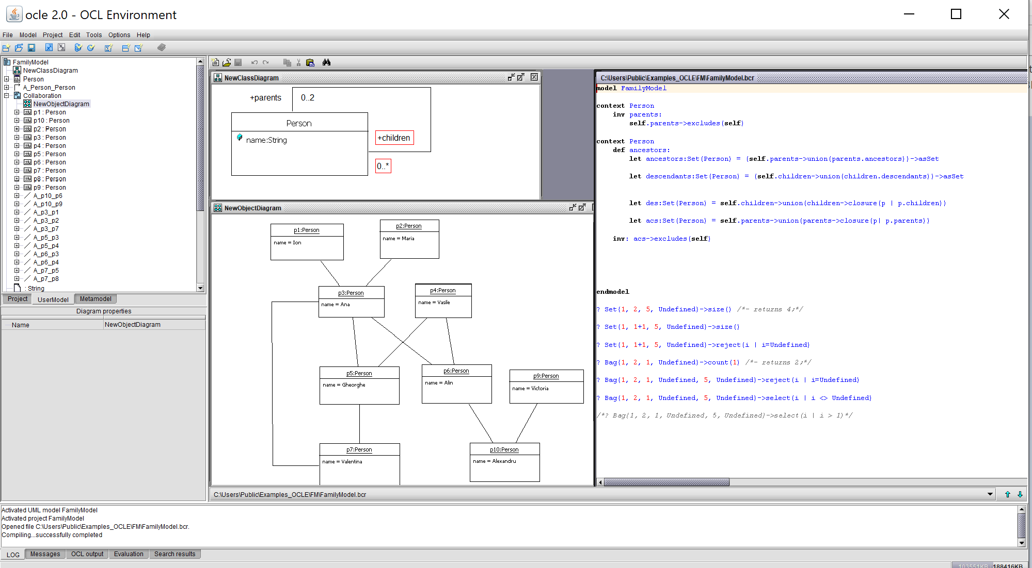

The Object Constraint Language
OCLE 2.0 http://lci.cs.ubbcluj.ro/ocle/

Slide 6
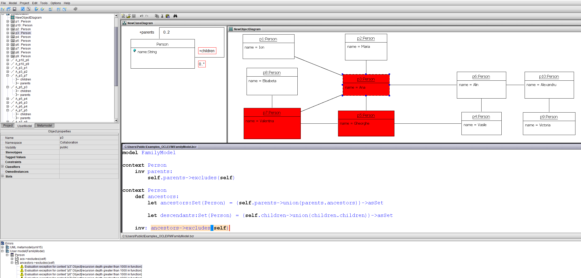
The Object Constraint Language
Recursive Specification Drawback

Slide 7
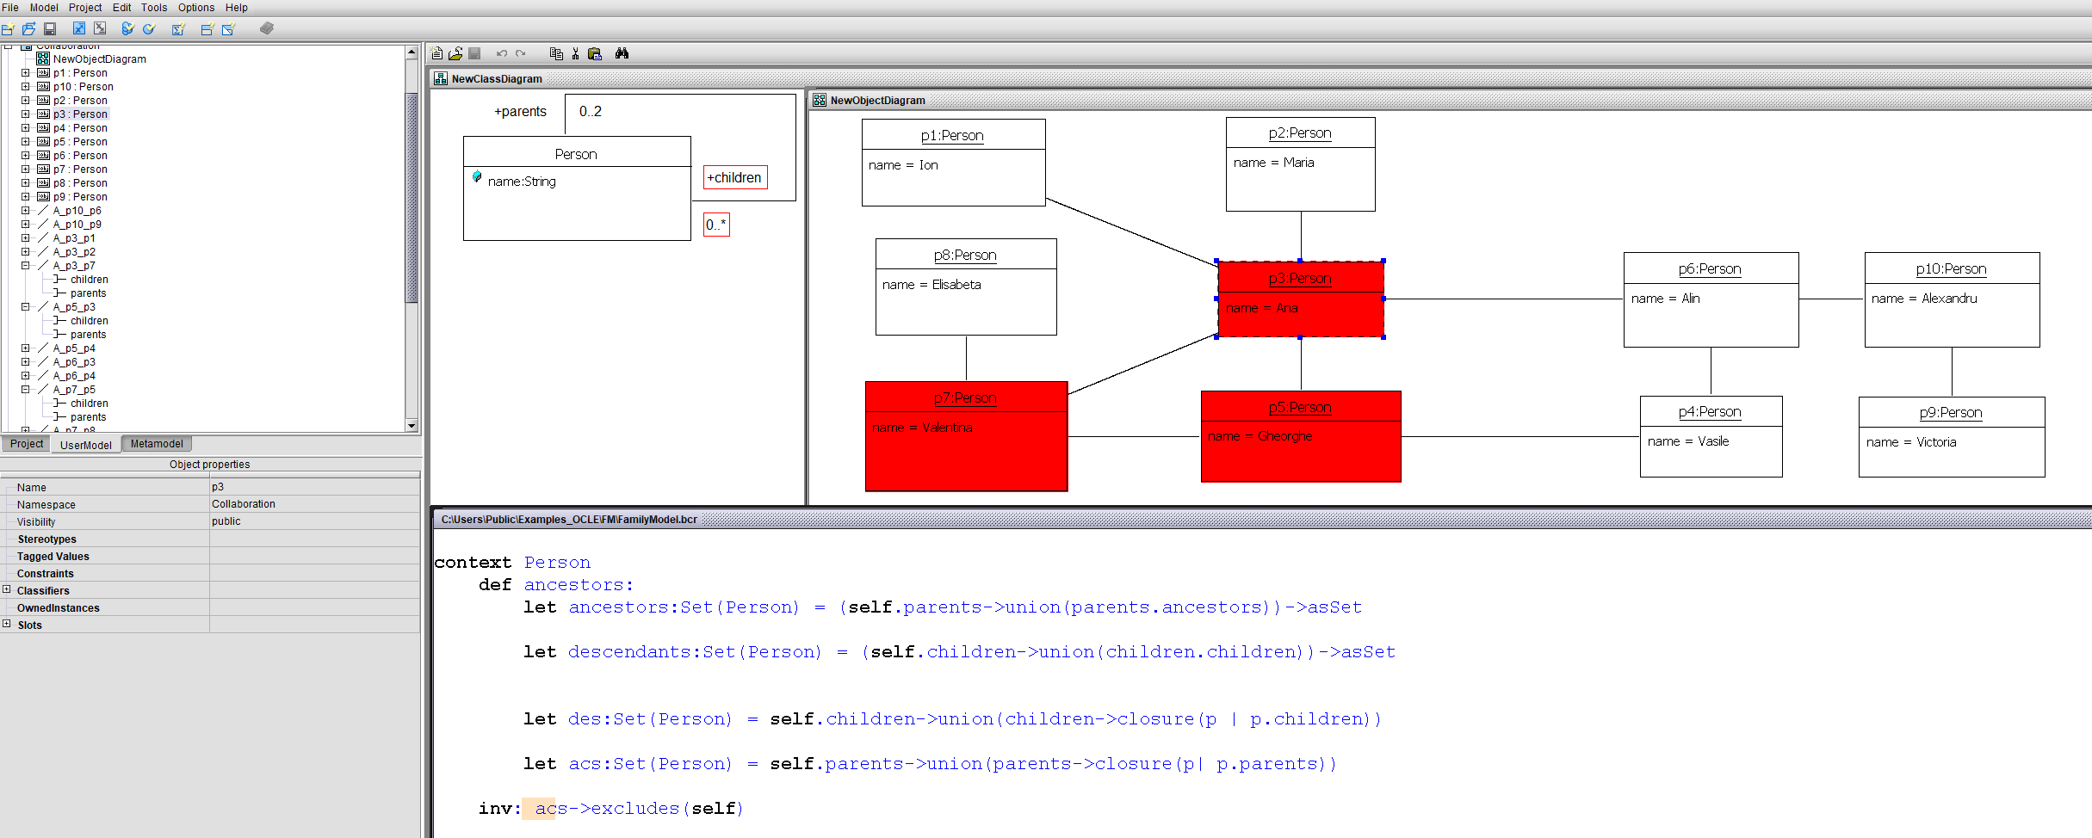
The Object Constraint Language
hidden specification errors

Slide 8
The Object Constraint Language
The context and main features
OCL has arise from the necessity of bridging an expressivity gap of UML
  diagrams are unable to capture most of the constraints imposed by nontrivial software systems
=> OCL is not a standalone language, but a language meant to complement UML. OCL expressions are meaningful in the context of a valid UML/(MOF based) model [except OCL literal expressions].
the current OCL standard is a side free effects (declarative) language. So, the evaluation of an OCL specification does not change the UML model

Slide 9
The Object Constraint Language
The context and main features 2
OCL is a typed language – all elements of OCL expressions are typed => the type of any OCL expression can be obtained by inference
OCL supports first order logic
the language supports main features of OOP. OCL specifications are inherited in descendants, where they may be overwritten. Constraint redefinition complies with the rules established in Design By Contract. The language supports type-casting, including upper type-casting

Slide 10
The Object Constraint Language
The purposes of using OCL
to support:
model navigation - querying the information in a model through (repeated) navigation of its association relationships using role names;
specification of assertions - explicit definition of pre/post-conditions and invariants, as promoted by Design by Contract;
definitions of behavior - body specifications for the query operations included in the model, derivation rules for existing attributes and references, as well as the definition of new operations and attributes for the model;
specification of guards, of type invariants for stereotypes, etc.

Slide 11
The Object Constraint Language
The purposes of using OCL 2
The objectives of using OCL go beyond the purpose of accomplishing a complete and unambiguous description of the problem solution by means of models.
The final target is to produce high quality software by using models. Translating model-level OCL specifications into code must be done in a natural an unequivocal manner. Moreover, the results obtained when evaluating OCL specifications on model instantiations should be equivalent to the results obtained at run time, when evaluating their corresponding code on similar configurations of objects.

Slide 12
The Object Constraint Language
OCL Types
Predefined types:
  Basic Types: Boolean, Integer, Real, and String
  Collections Types: Collection, Set, Bag, OrderedSet, and
  Sequence
User-defined types:
  Enumeration Type, Tuple Type
Types defined in the UML diagrams
OclAny, OclVoid, OclInvalid

Slide 13
The Object Constraint Language
OCL Types
Precedence order for operations, starting with highest:
  @pre
  dot and arrow operations: ‘.’ and ‘->’
  unary ‘not’ and unary minus ‘-’
  ‘*’ and ‘/’
  ‘+’ and binary ‘-’
  ‘if-then-else-endif’
  ‘<’, ‘>’, ‘<=’, ‘>=’
  ‘=’, ‘<>’
  ‘and’, ‘or’ and ‘xor’
  ‘implies’
Parentheses ‘(’ and ‘)’ can be used to change precedence
  Often useful simply to make it clearer

Slide 14
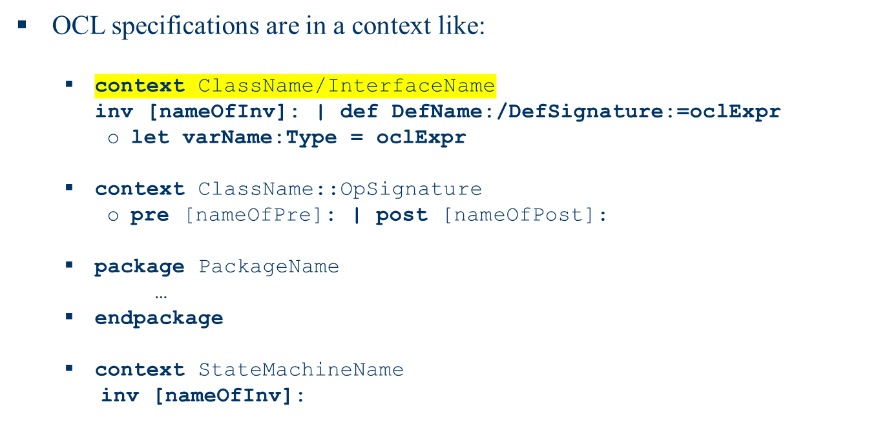
The Object Constraint Language
OCL specification

Slide 15
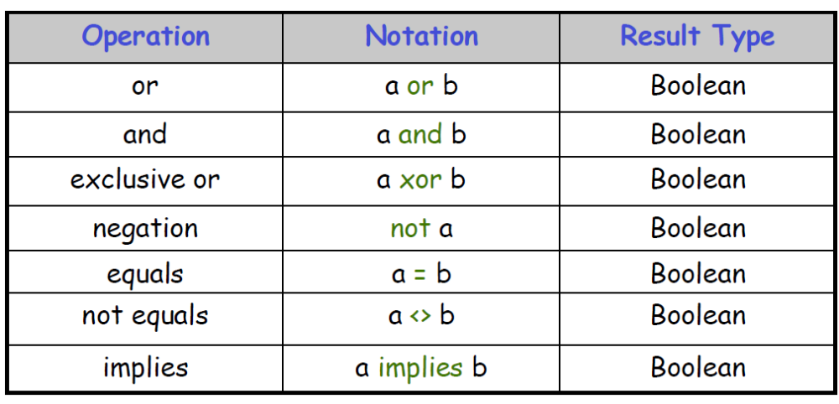
The Object Constraint Language
Boolean values

Slide 16
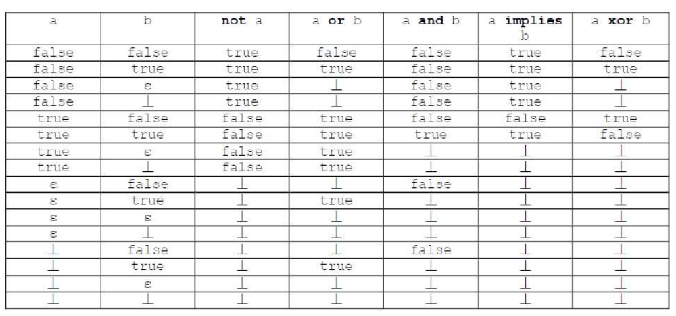
The Object Constraint Language
Boolean values 2
Four-valued logic(ɛ invalid value, ┴ undefined value)

Slide 17
The Object Constraint Language
Evaluating expressions containing undefined values
Set{1, 2, 5, Undefined}->size()
Set{1, 1+1, 5, Undefined}->size()
Set{1, 1+1, 5, Undefined}->reject(i | i=Undefined)
Bag{1, 2, 1, Undefined}->count(1)
Bag{1, 2, 1, Undefined, 5, Undefined}->reject(i | i=Undefined)
Bag{1, 2, 1, Undefined, 5, Undefined}->select(i | i <> Undefined)
Bag{1, 2, 1, Undefined, 5, Undefined}->select(i | i > 1)

Slide 18
The Object Constraint Language
Type system – important features
OclAny
OclAny is the supertype of all types in UML models and is an instance of the metatype AnyType. Features of OclAny are available on each object. Each class of UML user models inherits all operations defined on OclAny. Most of them are basic operations in object-toriented languages, such as:
    • operations for testing the equality of two objects
      – =(object2:OclAny):Boolean
      – <>(object2:OclAny):Boolean
    • operations inferring the objects type or state
      – oclIsTypeOf(type:Classifier):Boolean
      – oclIsKindOf(type:Classifier):Boolean
      – oclType():Classifier
      – oclIsInState(statespec:OclState):Boolean

Slide 19
The Object Constraint Language
Type system – important features 2
OclAny
    • operations specifying type casting
      – oclAsType(type:Classifier):T, where T is a classifier
    • other operations
      – oclIsNew():Boolean, conceived to be used in postconditions, to support the identification of objects created after the method starts executing
      oclIsUndefined():Boolean and oclIsInvalid():Boolean are two operations returning true when the receiver object or data value is undefined/unknown or when an exception has been triggered, respectively.

Slide 20
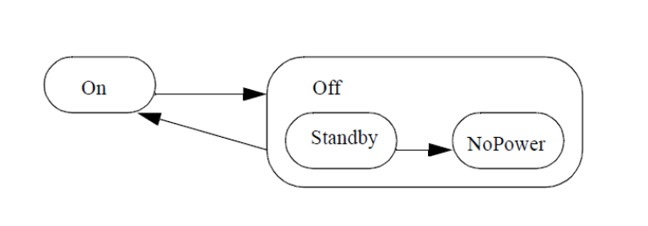
The Object Constraint Language
OclAny– oclIsInState
The operation oclInState(s) results in true if the object is in the state s. Values for s are
the names of the states in the statemachine(s) attached to the Classifier of object. For nested states the statenames can be combined using the double colon ‘::’ . In the example statemachine above, values for s can be On, Off, Off::Standby, Off::NoPower.
object.oclInState(On)
object.oclInState(Off)
object.oclInstate(Off::Standby)
object.oclInState(Off:NoPower)
If there are multiple statemachines attached to the object’s classifier, then the statename can be prefixed with the name of the statemachine containing the state and the double semicolon ::, as with nested states.

Slide 21
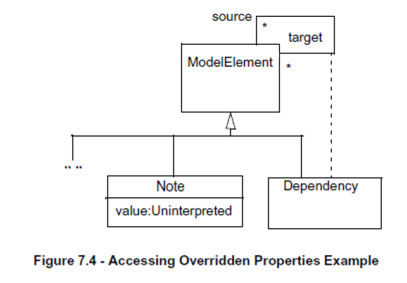
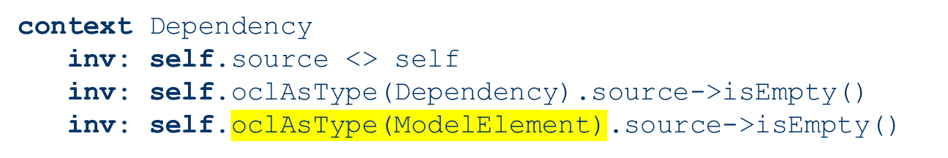
The Object Constraint Language
Accessing Overridden Properties

Slide 22
The Object Constraint Language
pre & post(conditions)
Constraint that specify the applicability and effect of an operation without stating an algorithm or implementation
Are attached to an operation in a class diagram
Allow a more complete specification of a system
Preconditions must be true just prior to the execution of an operation
Precondition
Syntax
context <classifier>::<operation> (<parameters>)
pre [<constraint name>]:
<Boolean OCL expression>

Slide 23
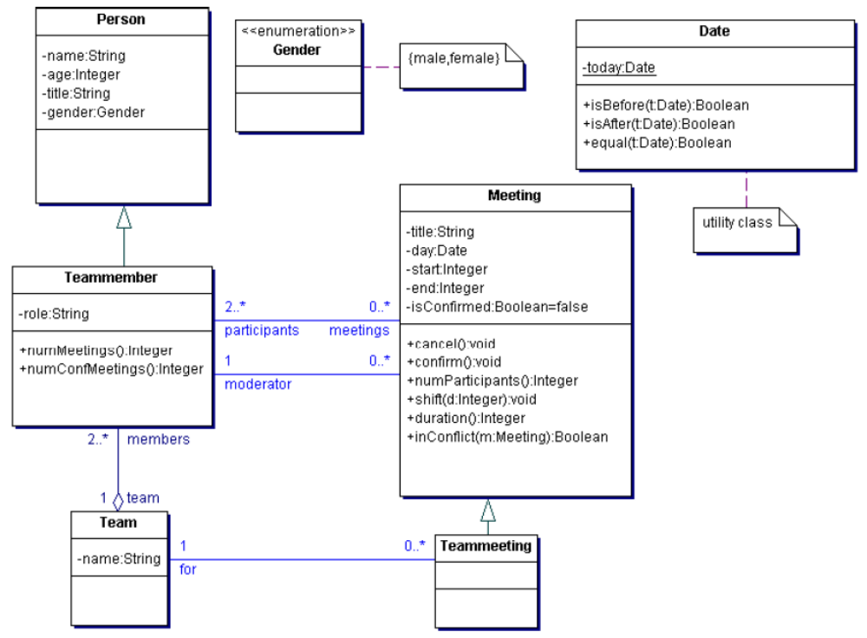
The Object Constraint Language
pre & post(conditions) 2

Slide 24
The Object Constraint Language
pre & post(conditions) 3
context Meeting::shift(d:Integer)
pre: self.isConfirmed = false
context Meeting::shift(d:Integer)
pre: d>0
context Meeting::shift(d:Integer)
pre: self.isConfirmed = false and d>0

Slide 25
The Object Constraint Language
pre & post(conditions) 4
Postcondition
  Constraint that must be true just after to the execution of an operation. Postconditions are the way how the actual effect of an
operation is described in OCL.
Syntax
context <classifier>::<operation> (<parameters>)
post [<constraint name>]:
<Boolean OCL expression>
vizElem@pre indicates a part of an expression which is to be evaluated in the original state before execution of the operation
vizElem refers to the value upon completion of the operation
@pre is only allowed in postconditions

Slide 26
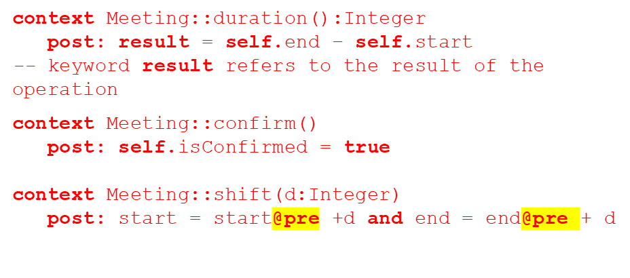
The Object Constraint Language
pre & post(conditions) 5

Slide 27
The Object Constraint Language
Collection types
Models are modeled by graphs => the need to navigate/query the model
At the class level, this is done by accessing the appropriate opposite association end. When the multiplicity of the association end is greater than 1, navigation will result in a Set. When the association end is adorned with {ordered}, the result will be an OrderedSet. Therefore, the collection types defined in the OCL Standard Library play an important role in OCL expressions.
Apart of the two above mentioned types, collection types also include Bag, Sequence and Collection, the latter being the common parent of the other four collection types.
The hierarchy and behavior of these types has been inspired by Smalltalk Collection classes.

Slide 28
The Object Constraint Language
Collection types 2
Usually, operations applied to collections are specified by using the arrow operator (->). This is meant to stress that, in case of collections, operations are potentially applied to many receivers (collection elements). However, in case of the collect operation, an exception (enabling to replace the -> operator with the dot operator (.)) is made.
So, the expression aCollection->collect(property) is equivalent to aCollection.property. This exception, known as ”shorthand collect”, is very used in practice, since it leads to slightly shorter specifications.

Slide 29
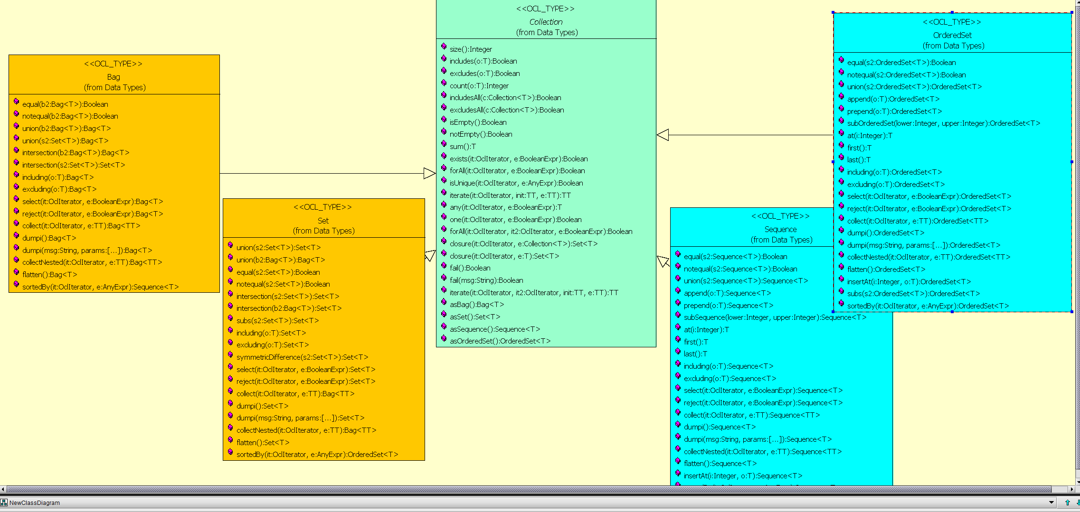
The Object Constraint Language
Collection hierarchy in OCL

Slide 30
The Object Constraint Language
Collection – the iterate operation
The iterate operation is very generic. All the operations: reject, select, forAll, exists, collect can all be described in terms of iterate.
  collection->iterate( elem : Type; acc : Type = <expression> | expression-with-elem-and-acc )
When the iterate is evaluated, elem iterates over the collection and the expression-with elem-and-acc is evaluated for each elem. After each evaluation of expression-with elem-and-acc, its value is assigned to acc. In this way, the value of acc is built up during the iteration of the collection.
  collection->collect(x : T | x.property)
  -- is identical to:
  collection->iterate(x : T; acc : T2 = Bag{}|acc->including(x.property))

Slide 31
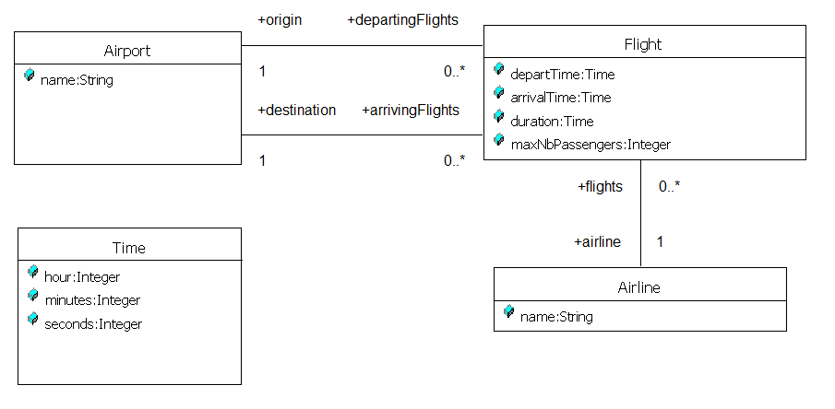
The Object Constraint Language
Collection types 3 - Navigating associations
Every association in the model is a navigation path.
The context of the expression is the starting point.
Role names are used to identify the navigated association.
  context Flight
  inv: origin <> destination
  inv: origin.name = "Amsterdam"

Slide 32
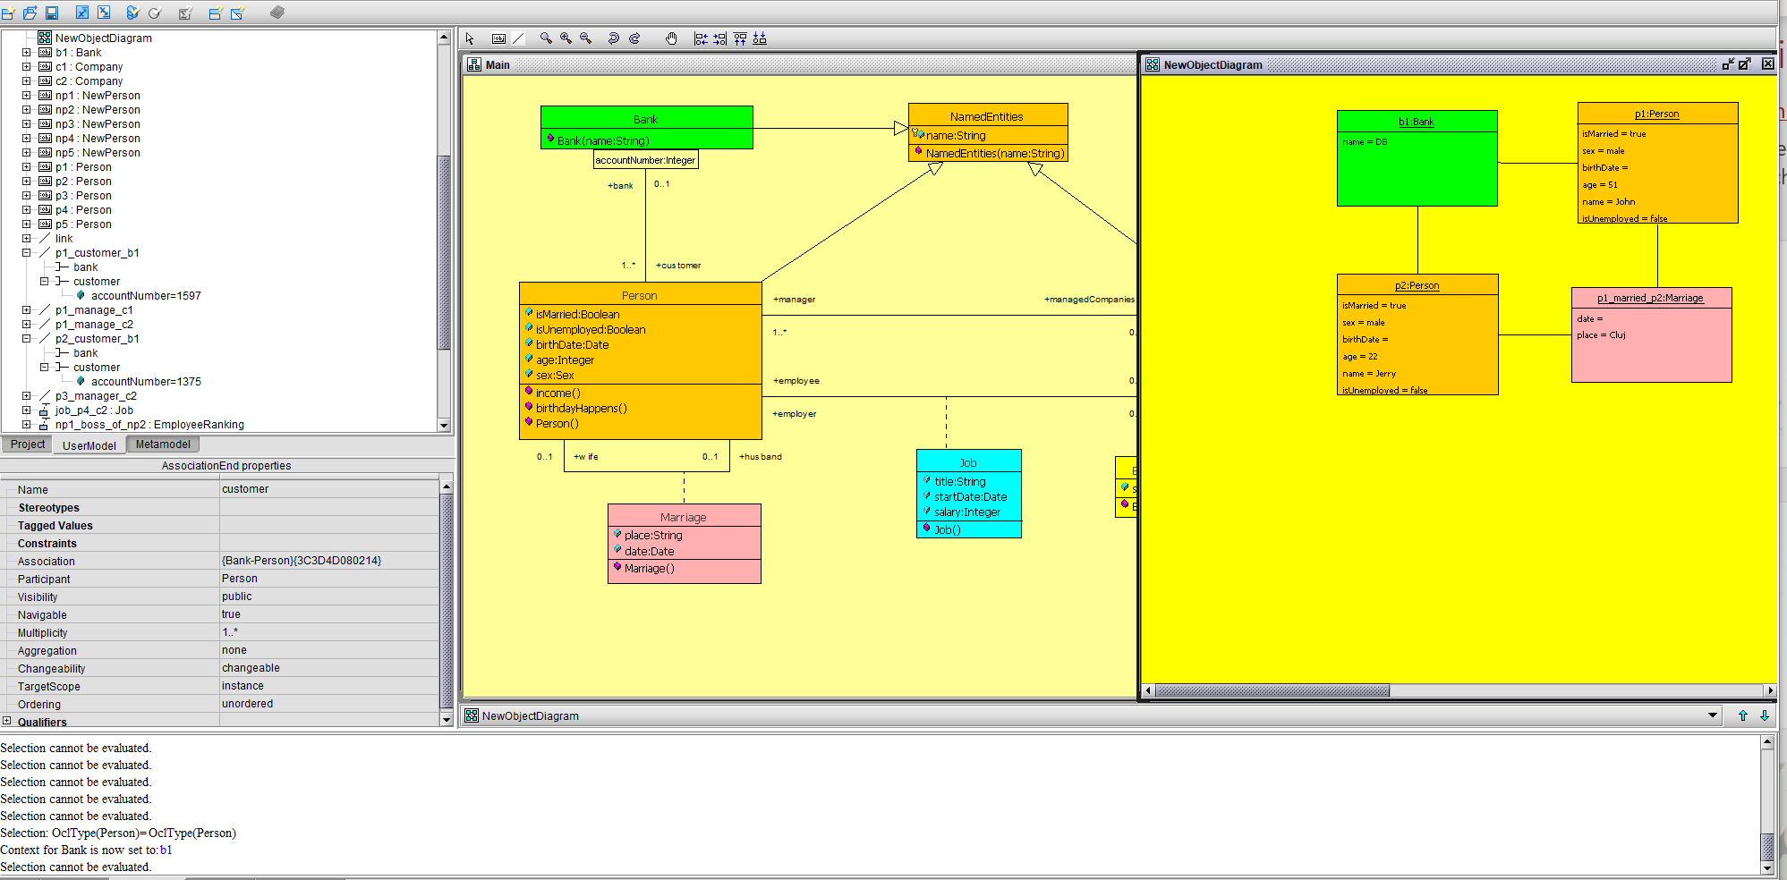
The Object Constraint Language
Qualified associations
context Bank
def customers:
let customers: Set(Person) = self.customer
inv differentClients:
self.customer[1597] <> self.customer[1375]
inv differentClients_2:
self.customer[1597] <> self.customer[1598]

Slide 33
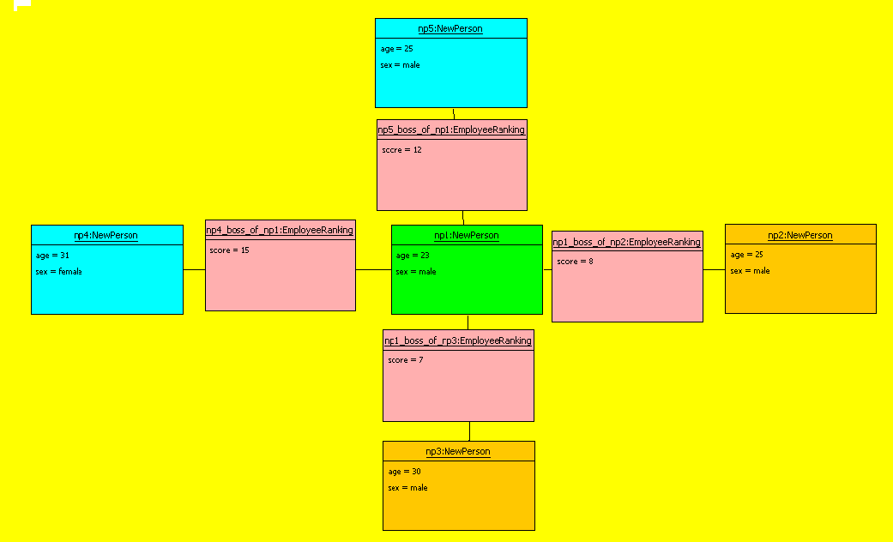
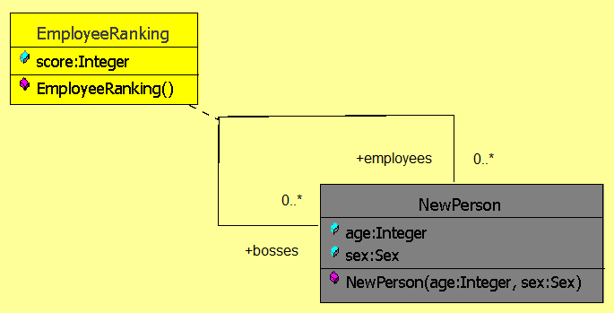
The Object Constraint Language
Association classes
context NewPerson
inv bosse_s_objectivy:
let nB: Integer = self.bosses->size
let nE: Integer = self.employees->size in
if nB*nE = 0
then true
else (self.employeeRanking[bosses].score->sum / nB) <= (self.employeeRanking[employees].score->sum / nE)
endif

Slide 34
The Object Constraint Language
Collection types 4 – the select & forAll operations
Syntax:
  collection->select(elem : T | expression)
  collection->select(elem | expression)
  collection->select(expression)
The select and reject operations does not change the type of the collection
The select operation results in the subset of all elements for which expression is true
Syntax:
  collection->forAll(elem : T | expr)
  collection->forAll(elem | expr)
  collection->forAll(expr)
The forAll operation results in true if expr is true for all elements of the collection. In case of medium and large size collections it’s difficult to find element(s) violating the invariant

Slide 35
The Object Constraint Language
Collection types 5 – the select operation
context Airport inv:
self.departingFlights->select(duration<4)->notEmpty
f1
duration = 2
airp1
f2
duration = 5
airline1
f3
duration = 3
airline2
airp2
f4
duration = 5
airline3
f5
duration = 2
departing flights
arriving flights

Slide 36
The Object Constraint Language
Collection types 6 – the forAll operation
context Airport inv:
self.departingFlights->forAll(departTime.hour>6)
f1
depart = 7
airp1
f2
depart = 5
airline1
f3
depart = 8
airline2
airp2
f4
depart = 9
airline3
f5
depart = 8
departing flights
arriving flights

Slide 37
The Object Constraint Language
Collection types 7 – the exists operation
Syntax:
  collection->exists(elem : T | expr)
  collection->exists(elem | expr)
  collection->exists(expr)
The exists operation results in true if there is at least one element in the collection for which the expression expr is true.

Slide 38
The Object Constraint Language
Collection types 8 – the exists operation
context Airport inv:
self.departingFlights->exists(departTime.hour<6)
f1
depart = 7
airp1
f2
depart = 5
airline1
f3
depart = 8
airline2
airp2
f4
depart = 9
airline3
f5
depart = 8
departing flights
arriving flights

Slide 39
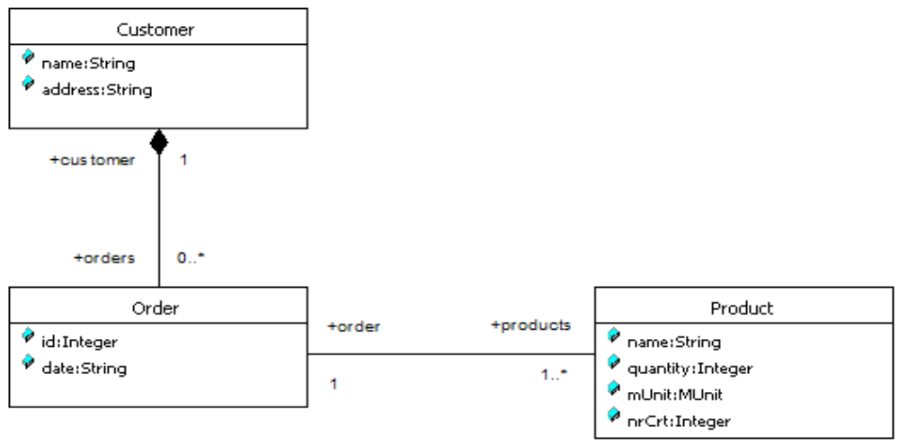
The Object Constraint Language
Collection types 9
Usually, users interested in knowing the products ordered by a customer evaluate the following OCL specification self.orders->collect(products).

Slide 40
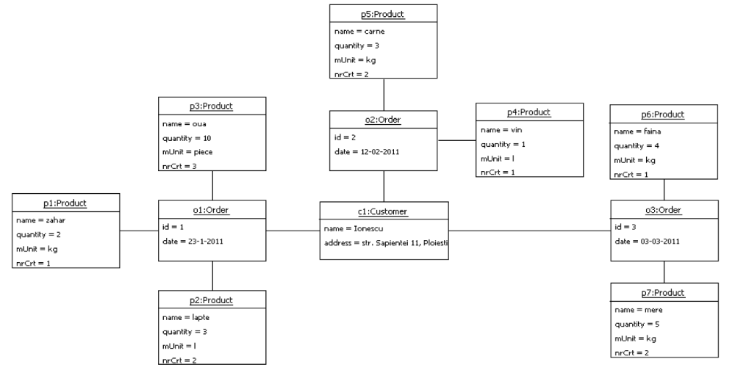
The Object Constraint Language
Collection types 10
context Customer
def productsOrderedByClient:Bag(Product)=self.orders.products
The result is: Bag{p1, p2, p3, p4, p5 , p6, p7}.

Slide 41
The Object Constraint Language
Collection types 11
More information can be obtained by using the collectNested operation:
context Customer
def productsOrderedByClient_cn:Sequence(Sequence(Product)) =
self.orders->collectNested(products)
The result returned by the OCL evaluator will be:
Sequence{Sequence{p1, p2, p3}, Sequence{p4, p5}, Sequence{p6, p7}}.
Compared with the result of the previous query, this time we know the products grouped by order, but we do not know the id or the reference of each order.

Slide 42
The Object Constraint Language
Collection types 12
Compared with the result of the previous query, this time we know the products grouped by order, but we do not know the id or the reference of each order. Slightly detailing the previous collectNested operation will support us in obtaining the missing information.
context Customer
def productsOrderedByClient_cnd:Sequence(Sequence(OclAny)) =
self.orders->collectNested(o| Sequence{o, o.products})
The result returned will be:
Sequence{ Sequence{o1, Sequence{p1, p2, p3}}, Sequence{o2, Sequence{p4, p5}}, Sequence{o3, Sequence{p6, p7}}}.

Slide 43
The Object Constraint Language
Collection types 13
Moreover, if one is interested in knowing the date of each order, the query can be refined as follows:
context Customer
def productsOrderedByClient_cndd:Sequence(Sequence(OclAny)) =
self.orders->collectNested(o| Sequence{o, o.date, o.products})
This returns:
Sequence{Sequence{o1,’23-1-2011’,Sequence{p1, p2, p3}},
Sequence{o2, ’12-02-2011’, Sequence{p4, p5}}, Sequence{o3,
’03-03-2011’, Sequence{p6, p7}}}.

Slide 44
The Object Constraint Language
Collection types 14
Using a TupleType, the specification could be rewritten as:
context Customer
def clientProducts_nsct:Sequence(TupleType(date:String,
id:Integer, ordProds:Sequence(Product))) =
self.orders->collectNested(o| Tuple{date=o.date, id=o.id,
ordProds = o.products})
Returning:
Sequence{Tuple{’23-1-2011’, 1, Sequence{p1, p2, p3}},
Tuple{’12-02-2011’, 2, Sequence{p4, p5}}, Tuple{’03-03-2011’,
3, Sequence{p6, p7}}}.

Slide 45
The Object Constraint Language
Collection types 15
Each operation on collections can be specified by using the iterate operation. In our case, the last specification is equivalent to:
context Customer
def clientProducts_nsctI:Sequence(TupleType(date:String,
id:Integer, ordProds:Sequence(Product))) =
self.orders->iterate(o:Order; acc: Sequence(TupleType(date:String,
id:Integer, ordProds: Sequence(Product))) =
oclEmpty(Sequence(TupleType(date: String, id:Integer,
ordProds:Sequence(Product))))| acc->including(Tuple{date=o.date,
id=o.id, ordProds = o.products }))
This returns the same result. In case of using the iterate operation, the OCL specification is more complex than its equivalent using collectNested. This is because the iterate operation is the most generic operation on collections.

Slide 46
The Object Constraint Language
Collection types 15 - other operations on collections
isEmpty: true if collection has no elements
notEmpty(): true if collection has at least one element
size: number of elements in collection
count(elem): number of occurences of elem in collection
includes(elem): true if elem is in collection
including(elem): returns a collection a similar collection including elem
excludes(elem): true if elem is not in collection
includesAll(coll): true if all elements of coll are in collection

